Slide 1
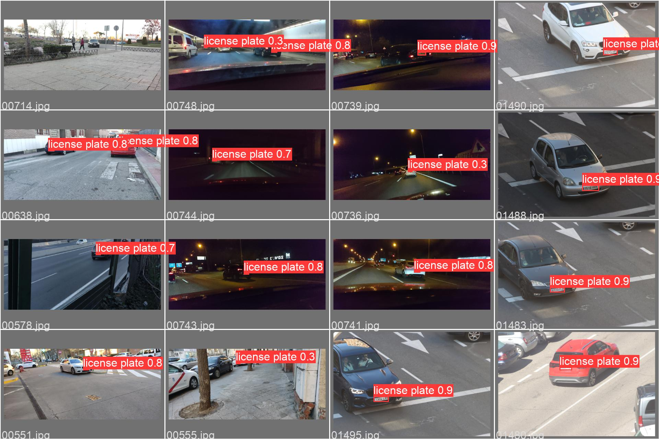
Proof-of-Concept Design of a Distributed IoT System with Edge Computing & Storage Requirements
By: Andrés Navarro Pedregal
Tutor: David Larrabeiti López

Slide 2
Table of contents
01
02
03
04
05
06
Introduction & Objectives
Technical Details
Development
Testing
Problems Encountered
Conclusions

Slide 3
01
Introduction & Objectives

Slide 4
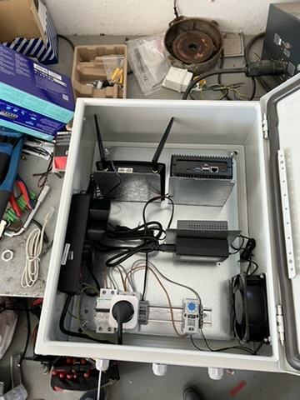
Project
Part of a collaboration with ATES SL (business in Valencia)
Study the viability of a IoT System for automatic parking management
Developed in conjunction with the Automatic & Robotics department

Slide 5
Problem
💻
☁️
📸
🧍‍♂️
🚘
🚪
🏢
🏢
🏢
🏢
🏢
🏢
🏢
🏢
🏢
🏢
🏢
Notes:
cloud

Slide 6
Objectives
Build a scalable parking management system
Make it autonomous and fully automated
Create a adaptable system for smart communities

Slide 7
02
Technical Details

Slide 8
Requirements
System able to recognize license plates and open gates automatically
Owners manage their parking lots and authorize users to enter
Communities can be dynamically added, system must be scalable
Data must be stored on-sight, encrypted and secure
Application must be accessible from the internet

Slide 9
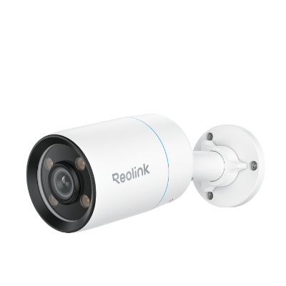

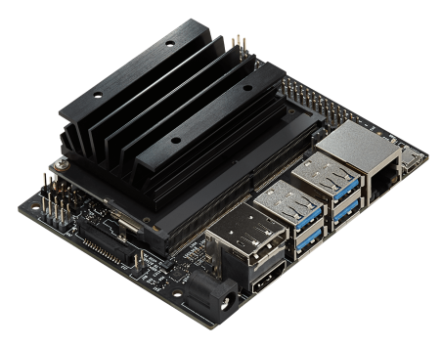
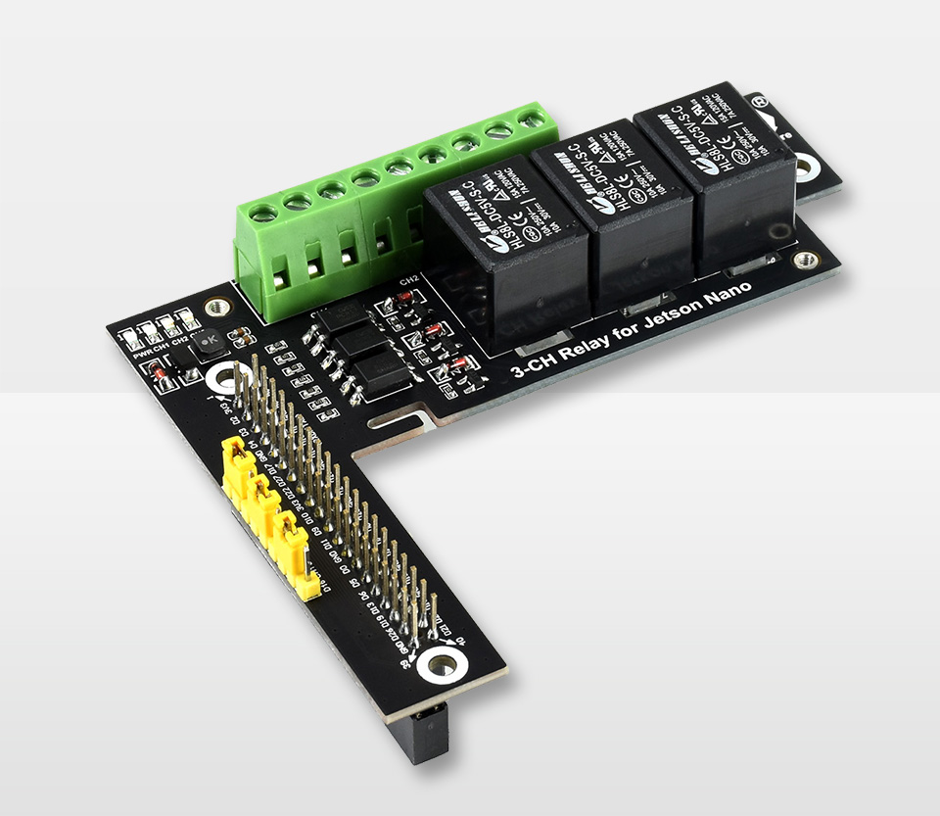



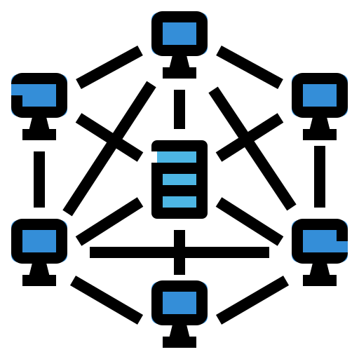


High Level Overview
Detection System
Actuators
Server
Terminal
Front-end
Back-end
Continuous Development
Networking
Database

Slide 10
Architecture
Community
🗄️ DB
👤 User
🤖 LP Detection
⚙️ Terminal
☁️ Server
🦾 Actuators
…
Community N
CD

Slide 11
03
Development

Slide 12
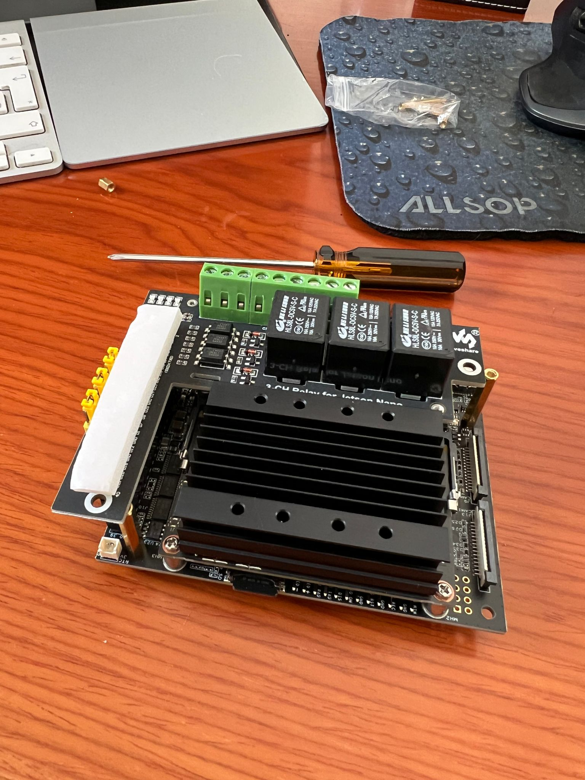
Terminal
Brains of the operation, Jetson Nano
API for the outside -> ExpressJS
Licence Plate Detection -> YOLO with PyTorch

Slide 13
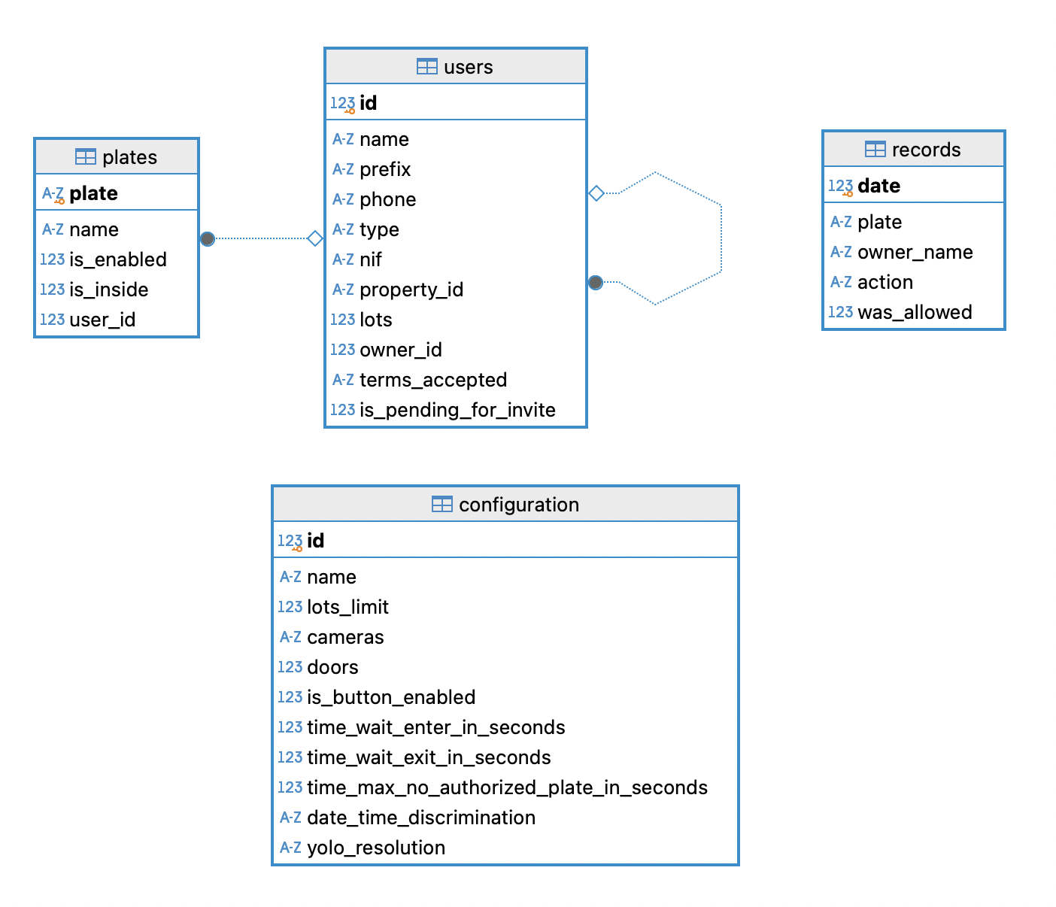
Database
Local DB with data encrypted
Backups on the cloud

Slide 14
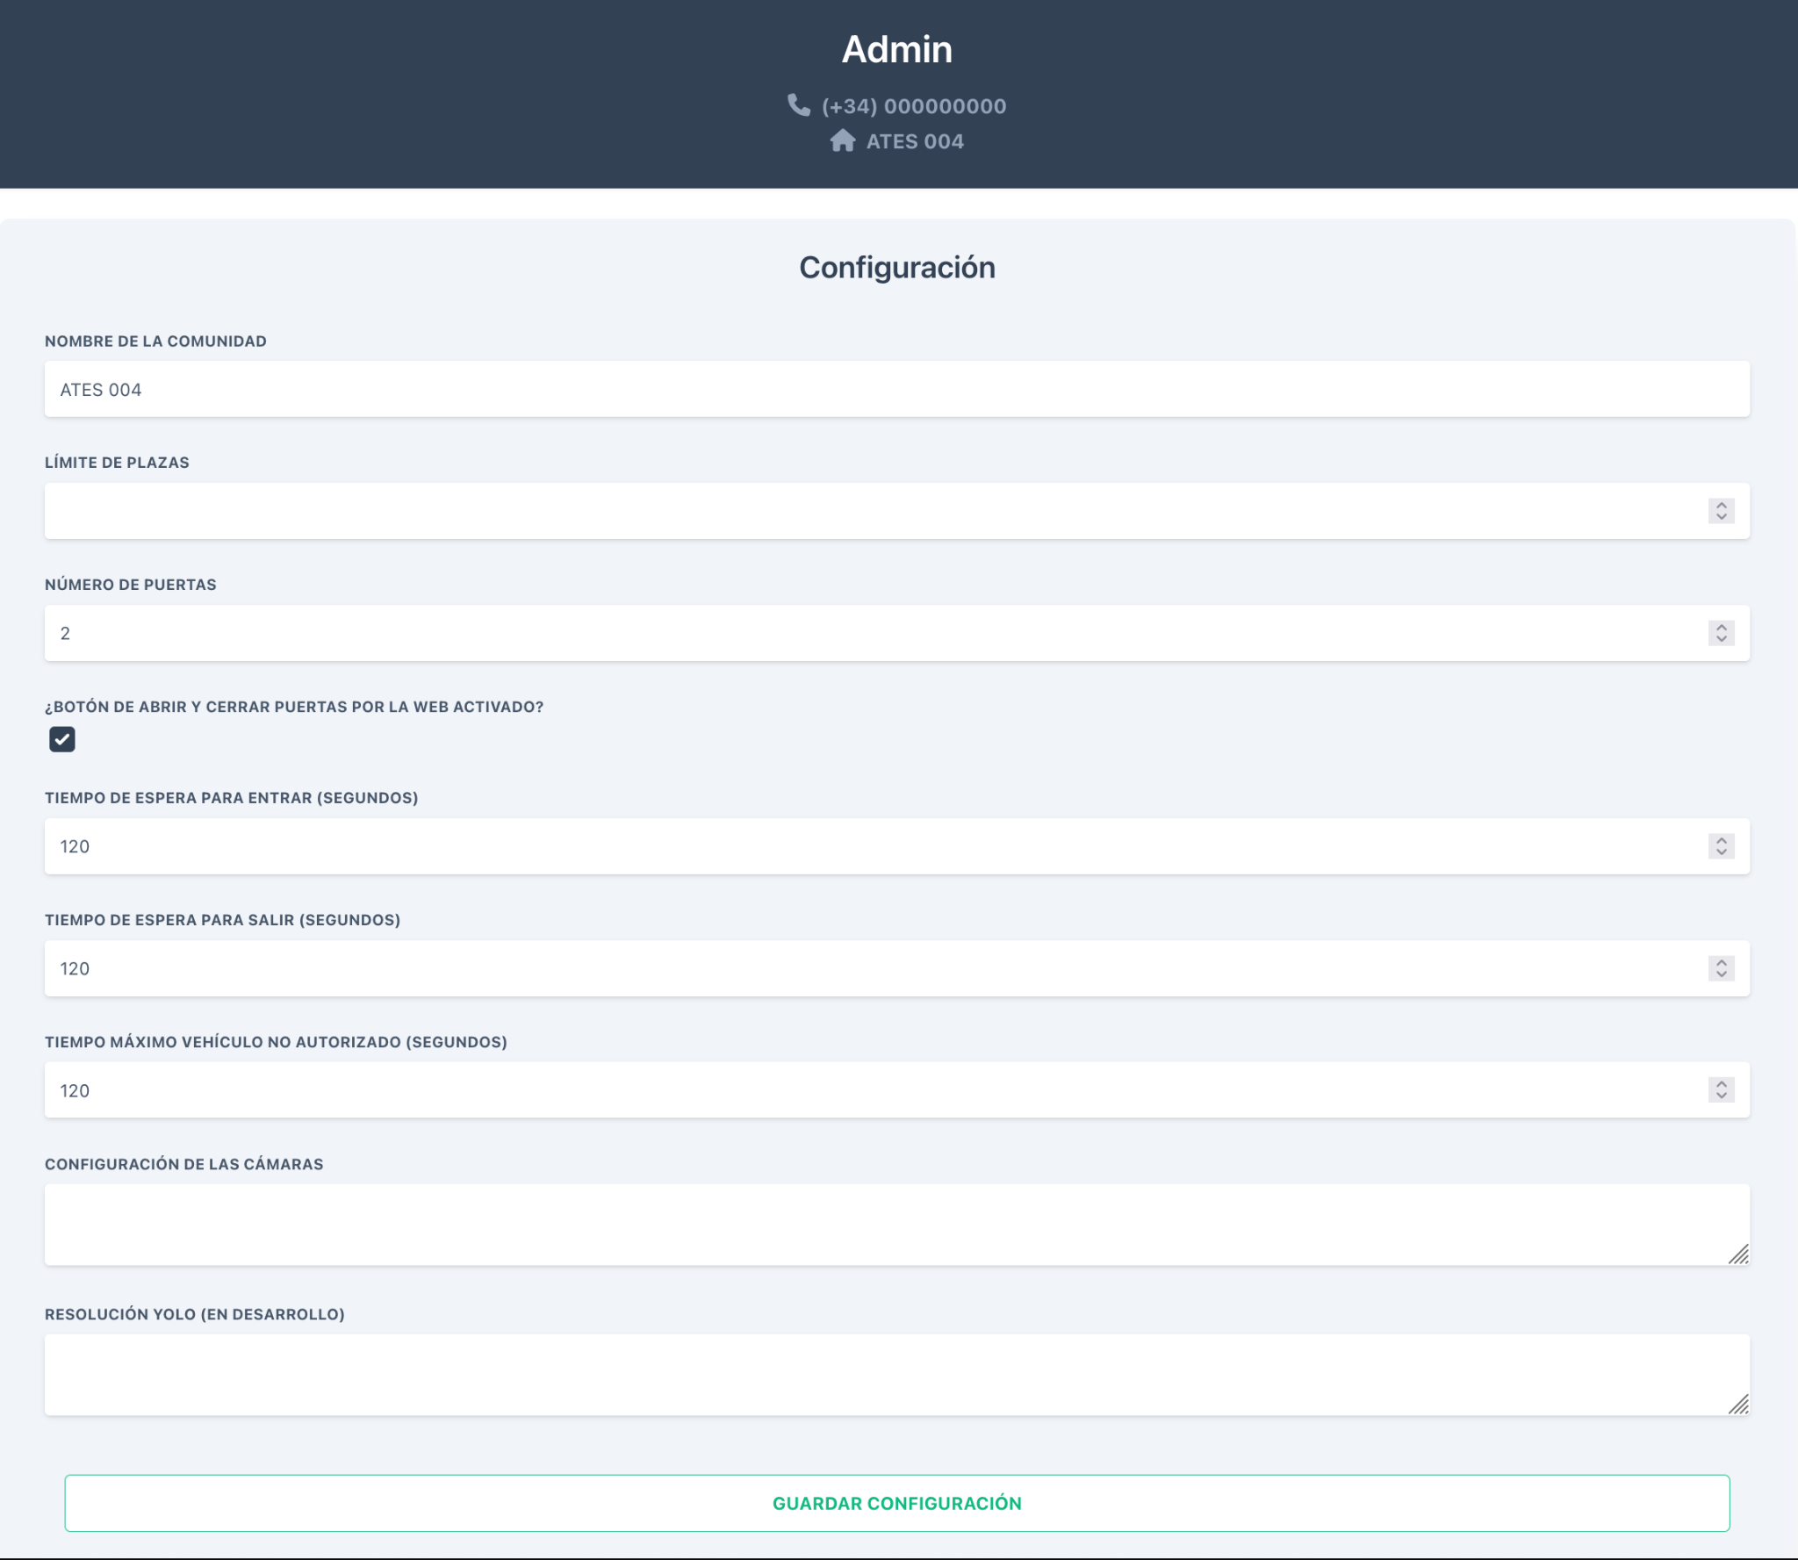
Server
Acts as the proxy to let users interact with the community
Backend -> NextJS
Frontend -> React
Relays all request to the specific community

Slide 15
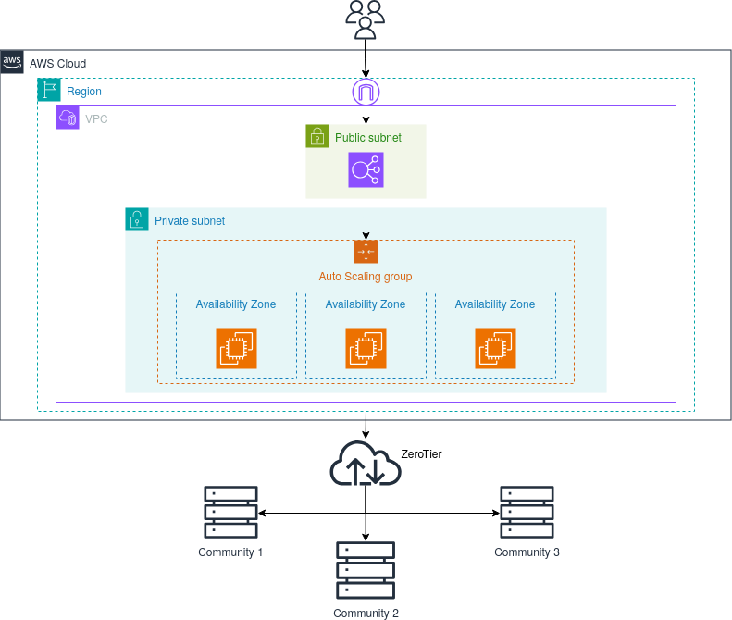
Server Architecture

Slide 16
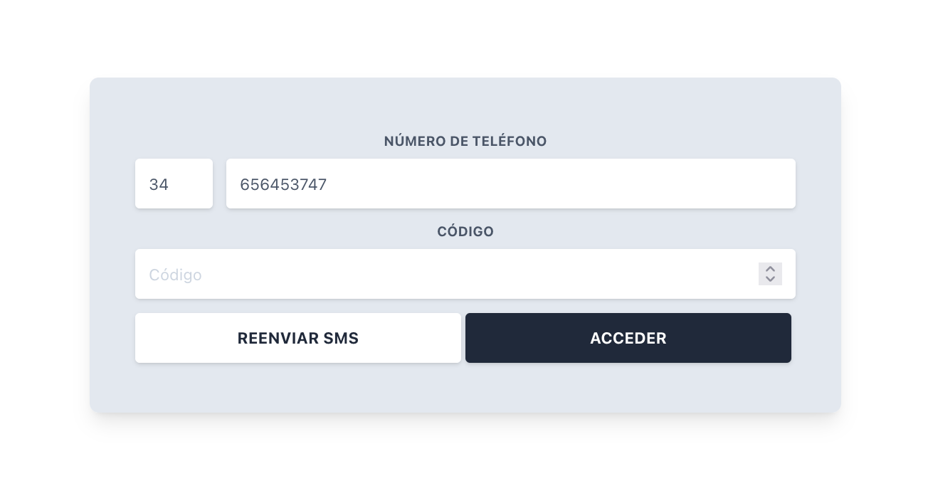
Authentication
Firebase
SMS login
JWT tokens

Slide 17
Networking
🏠 Community 1
👾 Server
🏠 Community 2
☁️ Internet
🌐 ZeroTier
…
🧍User
🏠 Community N

Slide 18
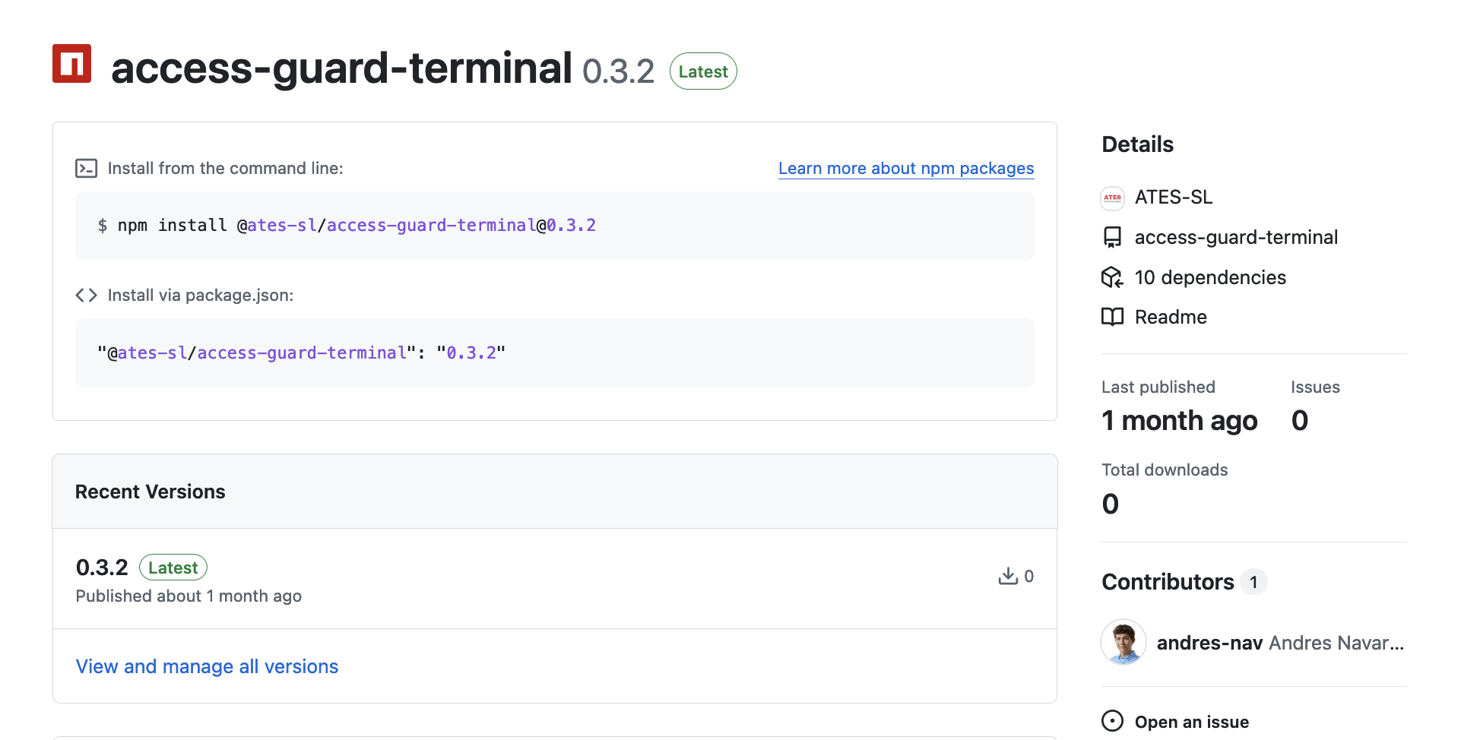
Deployment
Github Actions -> build packages
Ansible -> make the upgrades automatically (under development)

Slide 19
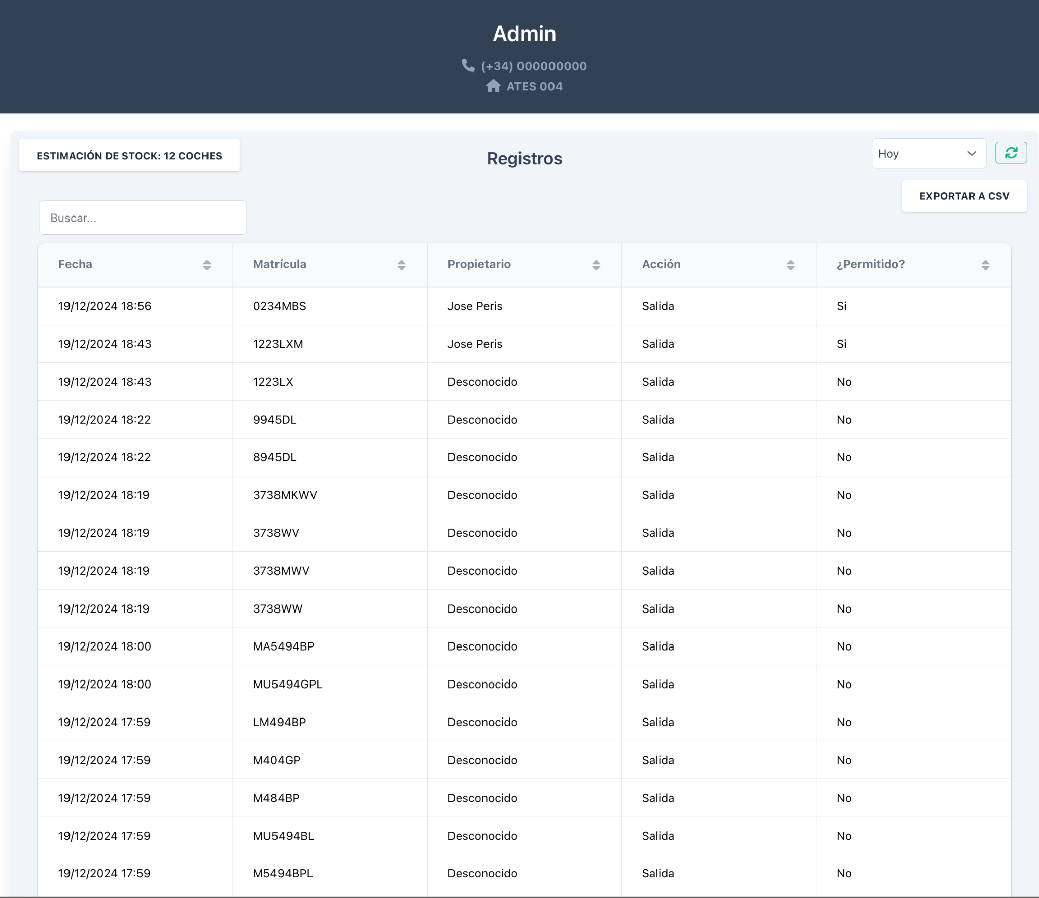
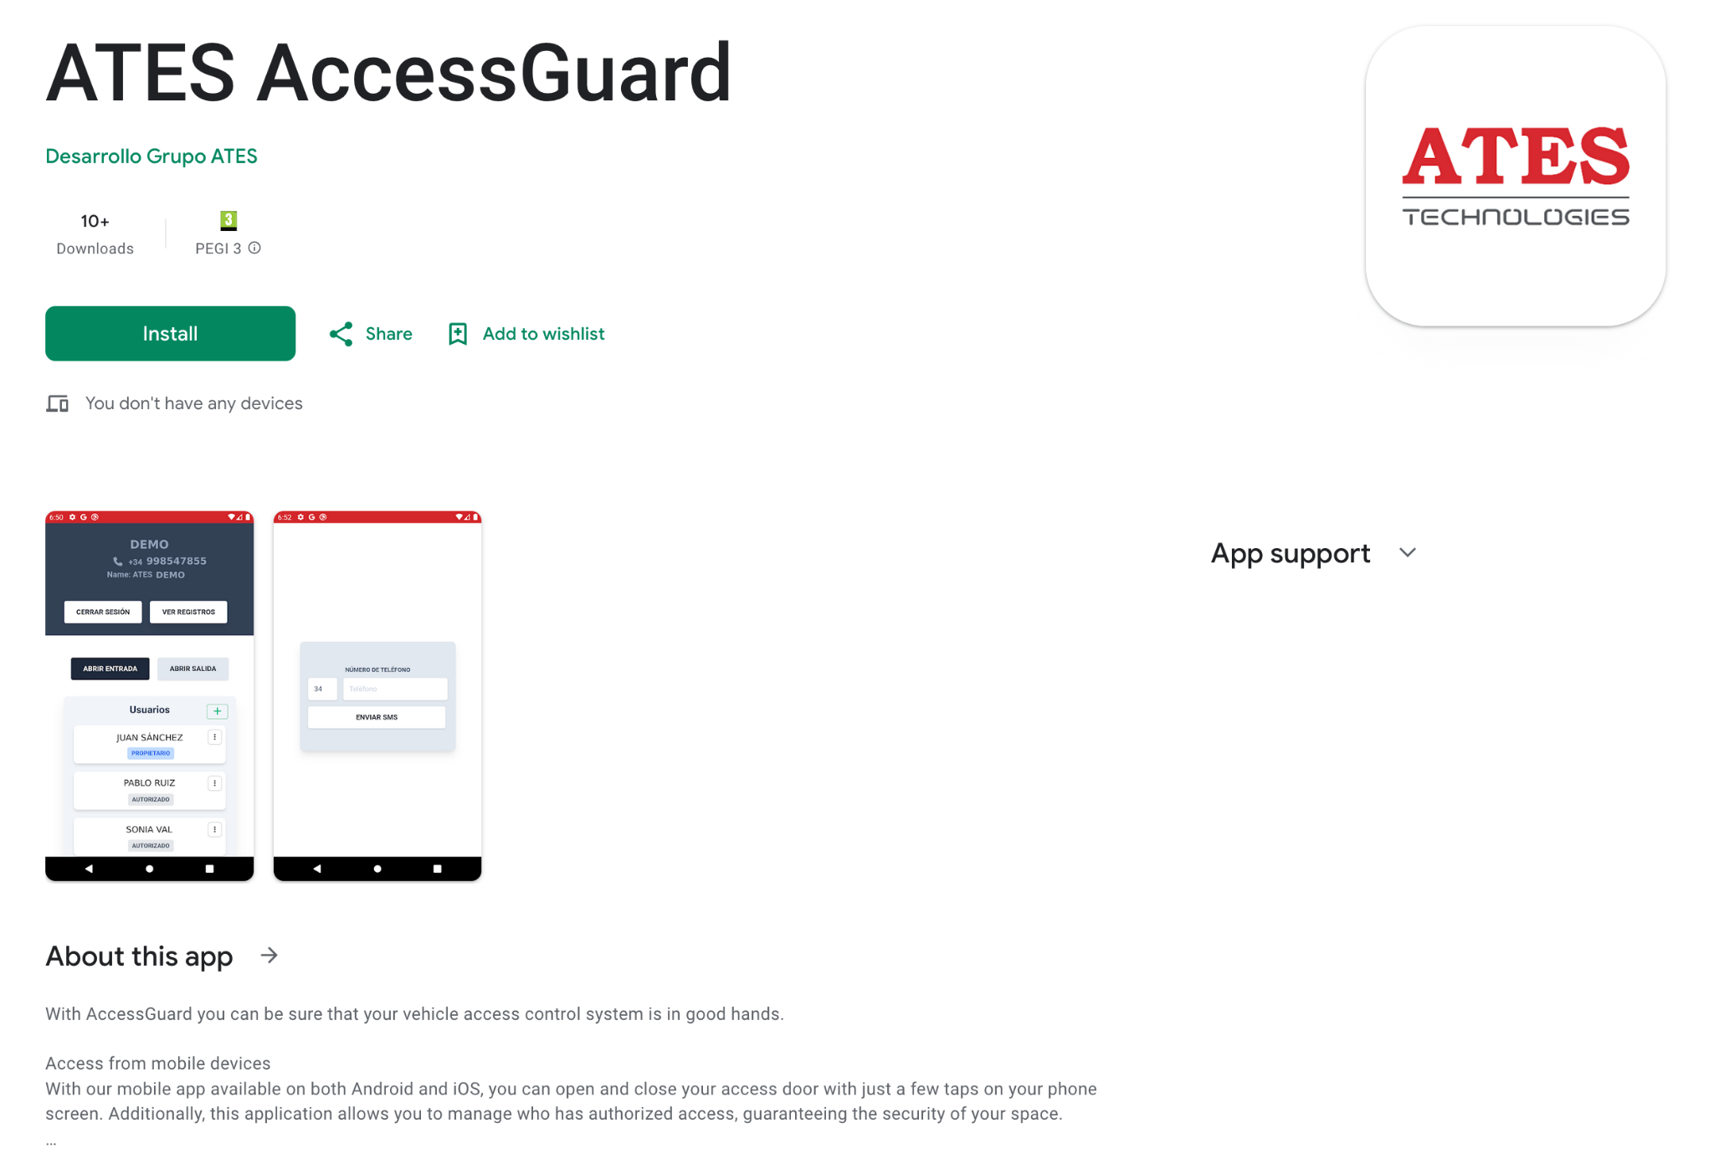
User Interface

Slide 20
04
Testing

Slide 21

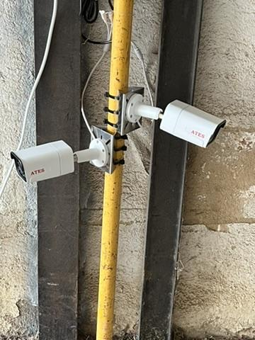
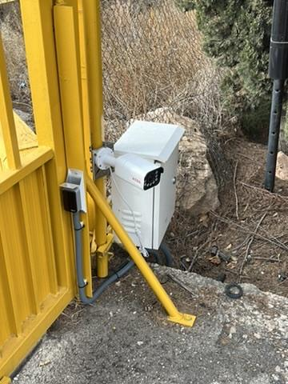
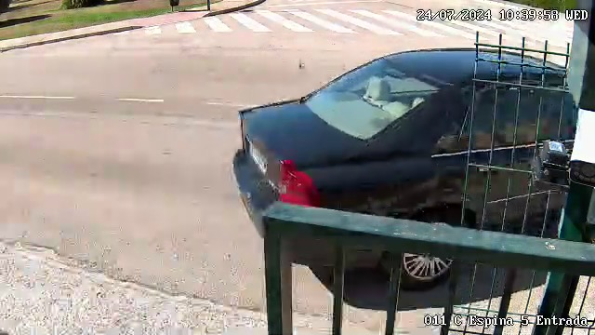
Testing

Slide 22
05
Problems Encountered

Slide 23
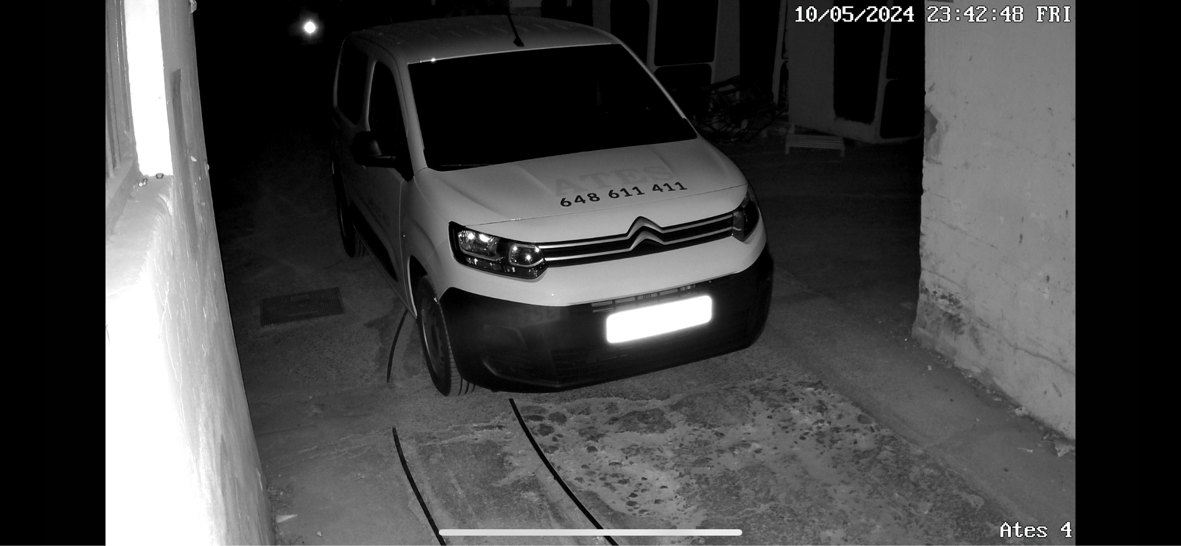
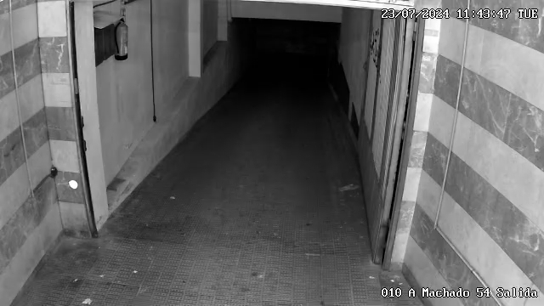
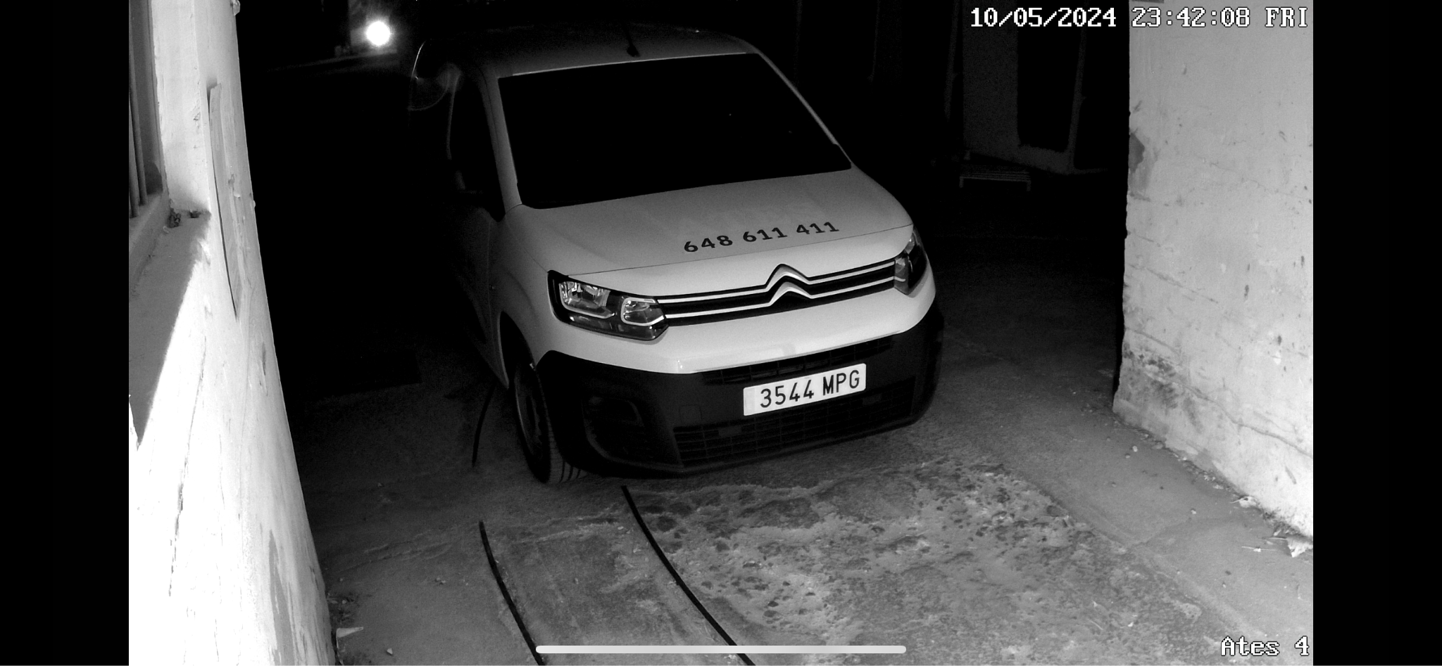
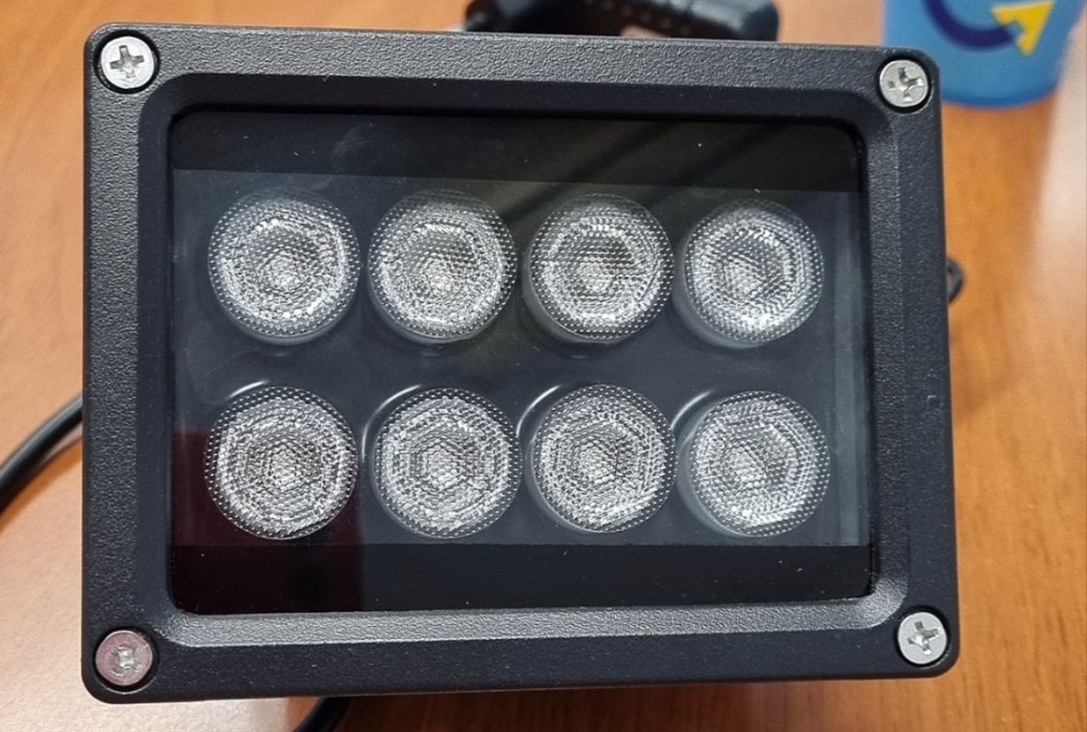
Low Lighting Problems
Fixed with Infrared Lights

Slide 24
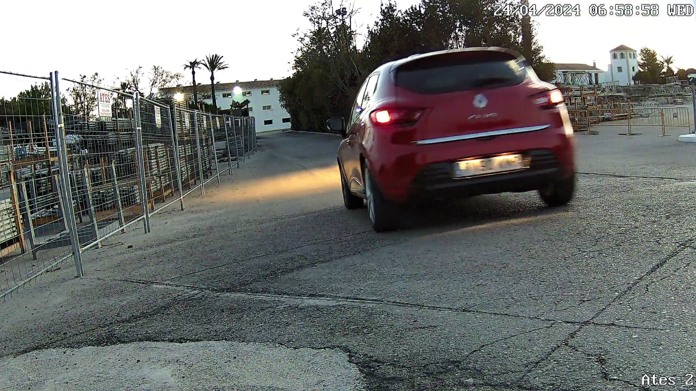
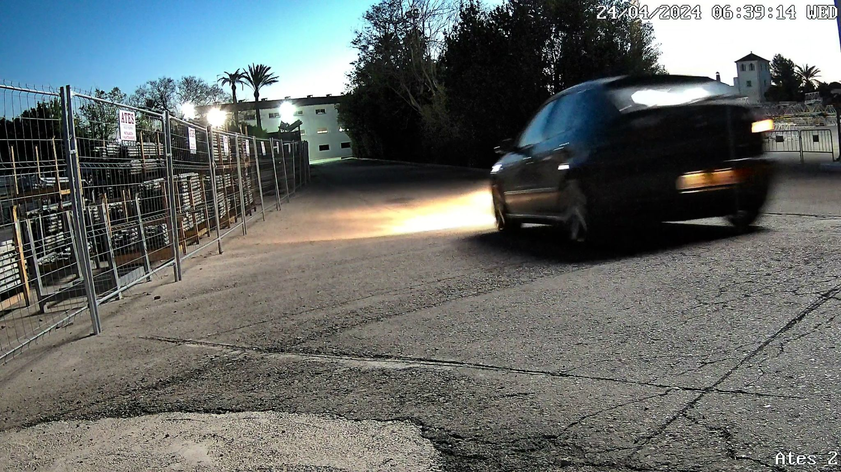
Speed
Fix improving camera efficiency

Slide 25
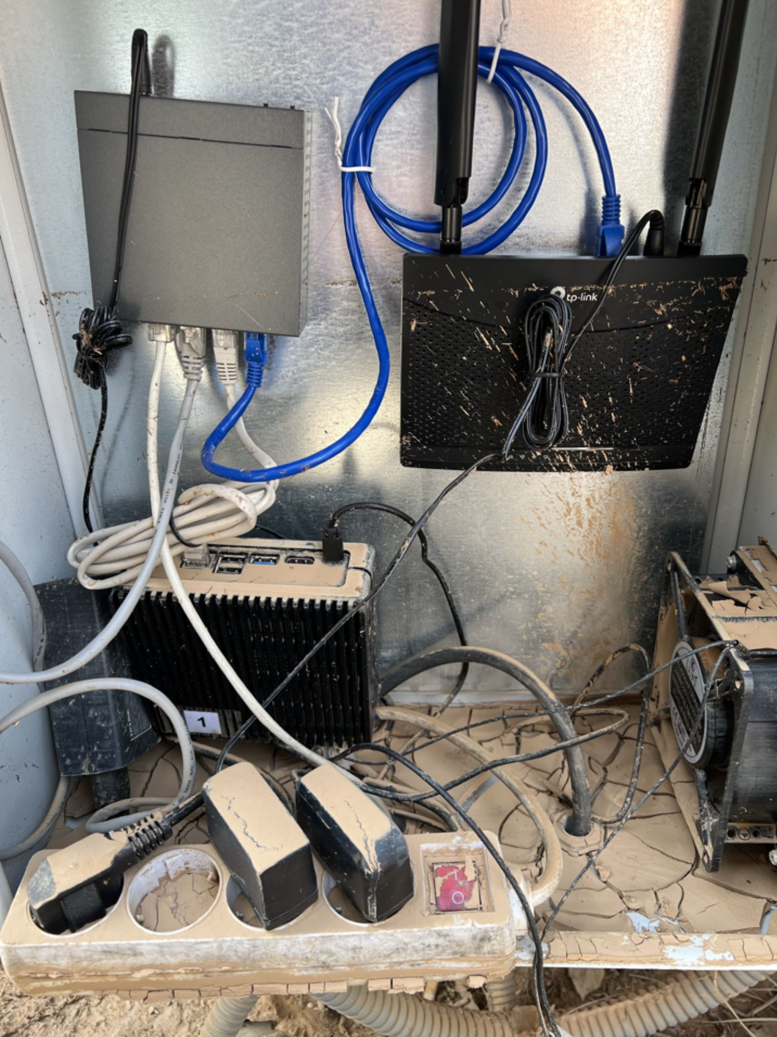
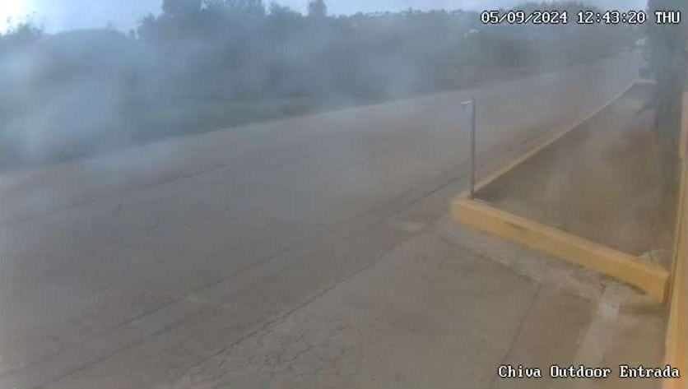
Weather

Slide 26
06
Conclusion

Slide 27
8 communities
99% uptime
Automatic detection

Slide 28
Lessons
Develop a software project from start to finish (design, implementation, and production)
Troubleshoot different problems
Communicate with stakeholders
The importance of monitoring and logging

Slide 29
Thank you!
Any questions?

